Slide 1
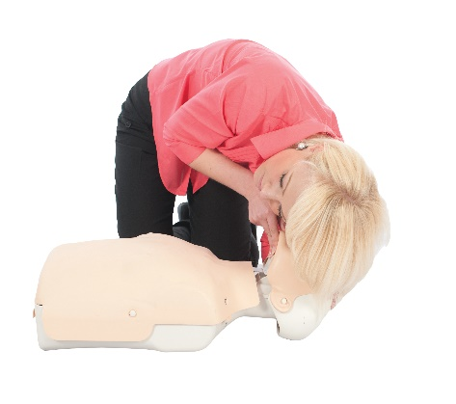
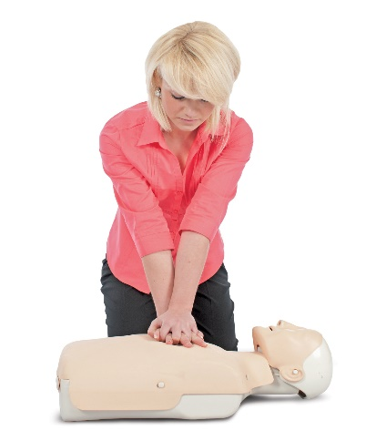
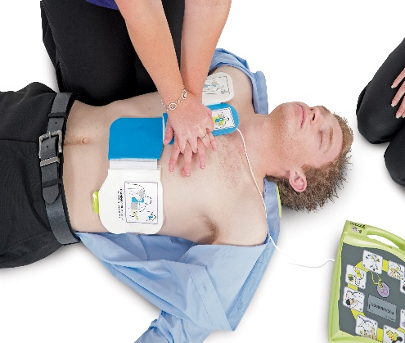
JPF First Aid
Qualification Training Course Offers
Staff Training Bundle 1
*All training bundles
are for a limited time and subject to availability. Offers are based on up to 12 staff attending on site at your location or by attending a venue organised by JPF First Aid. Please call 01543 471376 for more details.
Staff Training Bundle 1
Staff Training Bundle 2
3-Day First Aid at Work Course
1-Day Manual Handling Course
1-Day Fire Safety Course
All 3 courses for only:
£1250 - On-site at your location
or
£1400 - Staff to attend
JPF First Aid
1-Day Emergency First Aid at Work
Course
1-Day Manual Handling Course
1-Day Fire Safety Course
All 3 courses for only:
£820 - On-site at your location
or
£970 - Staff to attend
JPF First Aid
Staff Training Bundle 3
Staff Training Bundle 4
2-Day Paediatric First Aid
Course
1-Day Manual Handling Course
1-Day Fire Safety Course
All 3 courses for only:
£1075 - On-site at your location
or
£1225 - Staff to attend
JPF First Aid
2-Day First Aid at Work
Re-qualification Course
1-Day First Aid Risk Assessment Course
1-Day Fire Safety Course
All 3 courses for only:
£1180 - On-site at your location
or
£1330 - Staff to attend
JPF First Aid

